Slide 1


2023-2024 ROISD TAPR/Annual Report
Public Presentation March 24, 2025

Slide 2

Annual Report Includes:
2023-24 Texas Academic Performance Report (PDF TAPR)
  For the District and each Campus in the District
PEIMS Financial Standard Report (2022-23 Financial Actual Report)
  For the District and each Campus in the District
District Accreditation Status (2022-23 School Year)
Campus Performance Objectives
Report on Violent or Criminal Incidents on Campuses
Student Performance in Postsecondary Institutions
  For each High School Campus in the District
Progress Toward Board-adopted HB 3 Goals
2023-24 TAPR Glossary
The 2023-2024 District Annual Report is posted on the district's website at:
www.redoakisd.org/Page/2048
Notes:
This information is a compliance.
We provided all of this information in the fall so we can have plans and use the data from STAAR to impact our current year. The information we are providing today is the second time we have shared this information. Today is a compliance requirement so we will focus more on sharing the required information and less time on our plan since we focused on the plan in the Fall.
Every year the district presents an annual report. The annual report is in 8 sections. Most of the sections have already been presented in lengthier presentations earlier this school year. The annual report relies on the Texas Academic Performance Report also known as TAPR. The TAPR was released in December, 2024.

Slide 3
2023-2024 Texas Academic Performance Report (TAPR)
Data is compiled and provided by TEA for every district and campus using PEIMS and Student Assessment Data
The TAPR report provides information on student performance, the school and district staff, programs and demographics.
Notes:
Section 1 is known as the Texas Academic Performance Report (TAPR). The data is complied and provided by TEA for every district and campus. The TAPR provides information on student performance, the school and district staff, programs and demographics.

Slide 4
2023-2024 TAPR Report
      Cover Page
      Includes district or campus name and number
      District includes Special Education Determination Status:
        Meets Requirements
      The 2023-24 TAPR Glossary includes the following language:
      Currently, the TAPR does not include scale scores, A–F ratings or Distinction Designations. The initial release does not include the District or Campus Accountability Reports. The issuance of the A–F ratings under 2024 rule is pending and subject to change.
Notes:
The cover page of the TAPR usually provides information regarding ratings, however, Ratings for the 23-24 school year are pending. This year the cover sheet provides the district or campus name and number. The district cover page includes Special Education Determination Status Meets Requirements
This is an improvement in the area of Special Education because the district was Needs Intervention for the 22-23 school year.

Slide 5
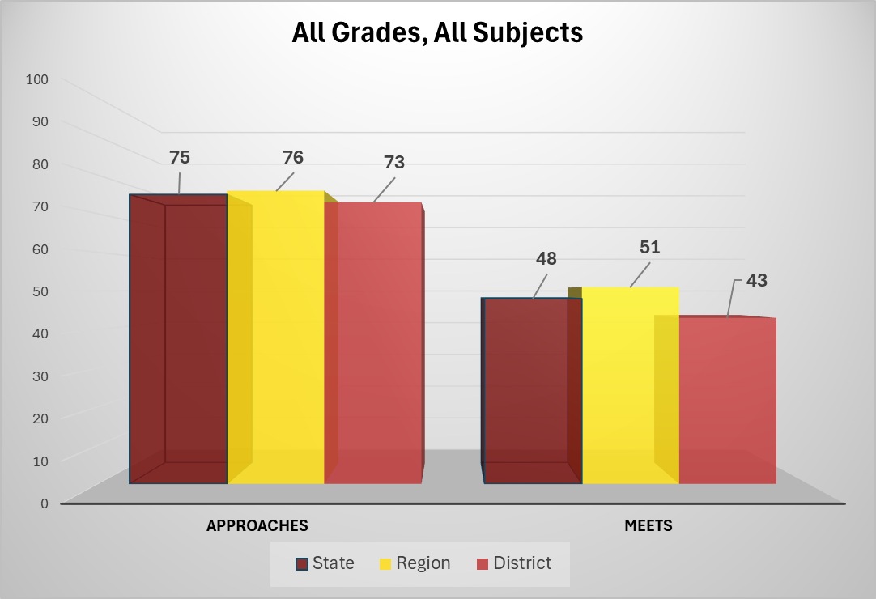
STAAR (State/Region/District)
Notes:
We have covered results from STAAR and EOC previously. The TAPR allows districts to compare results across state and region as well. This comparison represents all grades and all subjects. It is important to point out the STAAR assessment had significant changes in the last year.

Slide 6
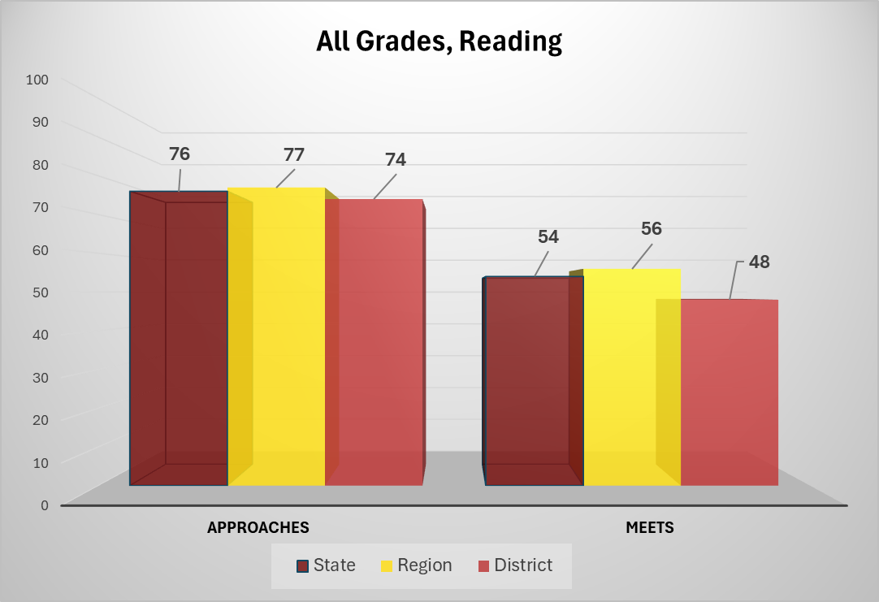
STAAR
Notes:
Reading STAAR also included writing elements for all grades.

Slide 7
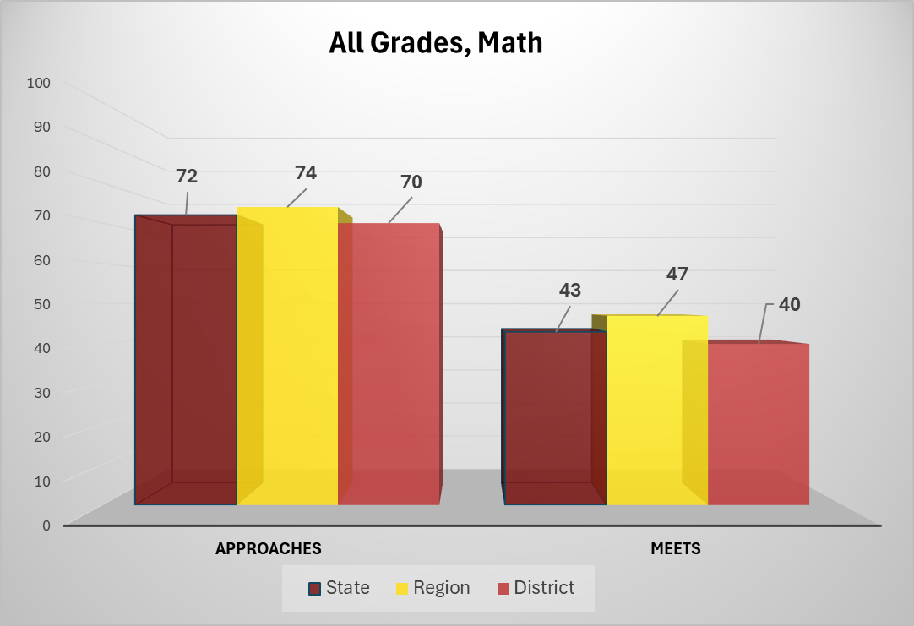
STAAR
Notes:
Math STAAR included different item types.

Slide 8

STAAR

Slide 9
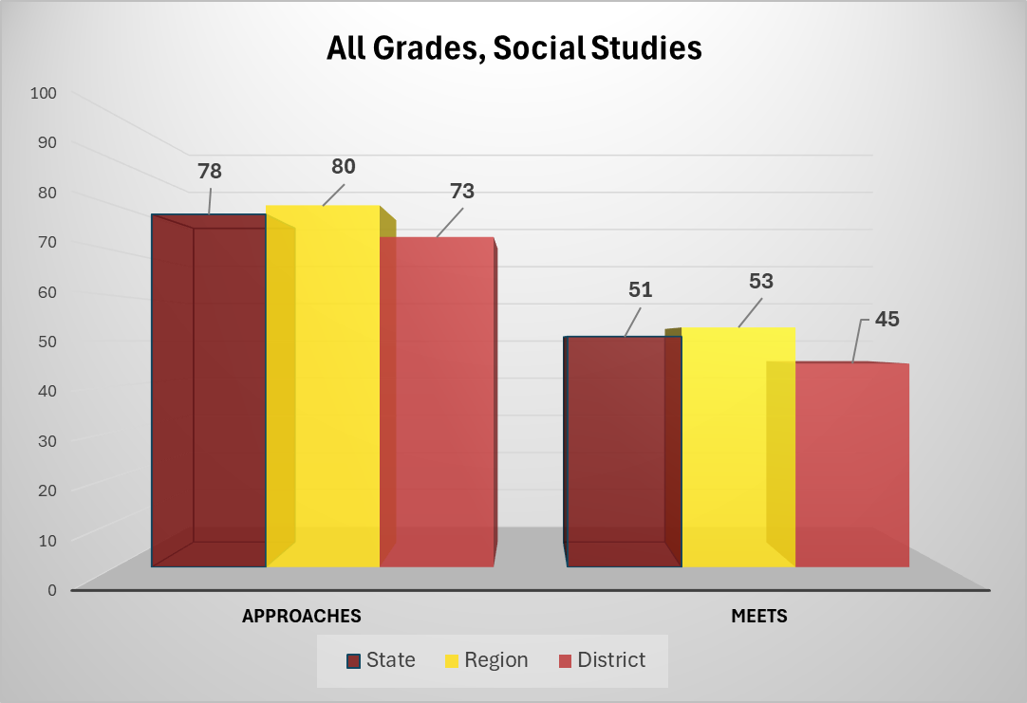
STAAR

Slide 10
School Progress – Annual Growth
 | School Year | State | Region | District
All Grades Both Subjects | 2024 | 64% | 65% | 64%
 | 2023 | 64% | 66% | 57%
All Grades Reading | 2024 | 67% | 68% | 65%
 | 2023 | 63% | 65% | 57%
All Grades Math | 2024 | 60% | 62% | 62%
 | 2023 | 66% | 68% | 58%
Notes:
This slide reviews the annual growth.
Students and staff are becoming more familiar with STAAR 2.0. We have seen growth in the area of writing over the last 2 years. This data reviews all students in the area reading and math and how all students grow from one year to the next year.
Annual growth is the percentage of students that grew academically by at least one school year. Annual growth is only calculated for math and reading.

Slide 11
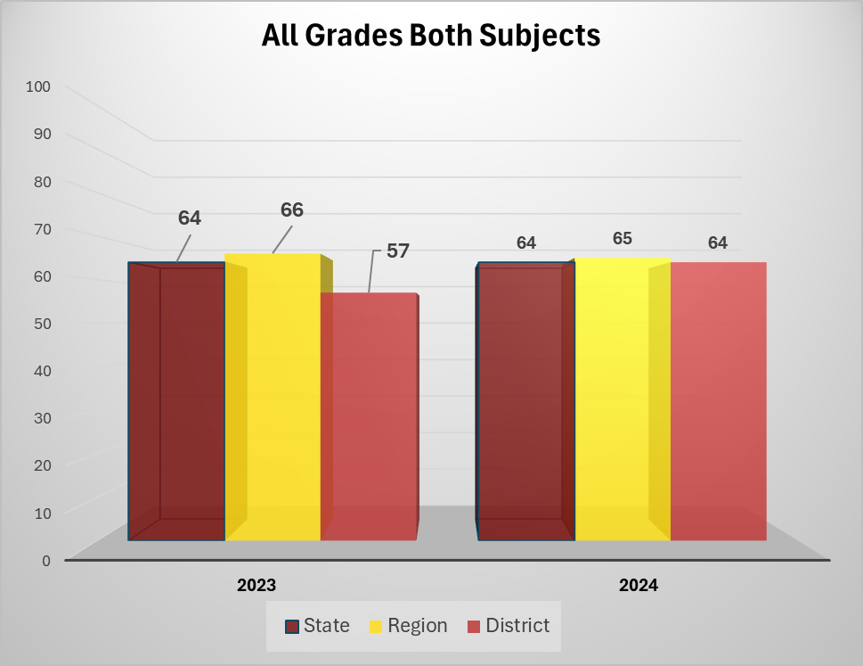
School Progress – Annual Growth

Slide 12
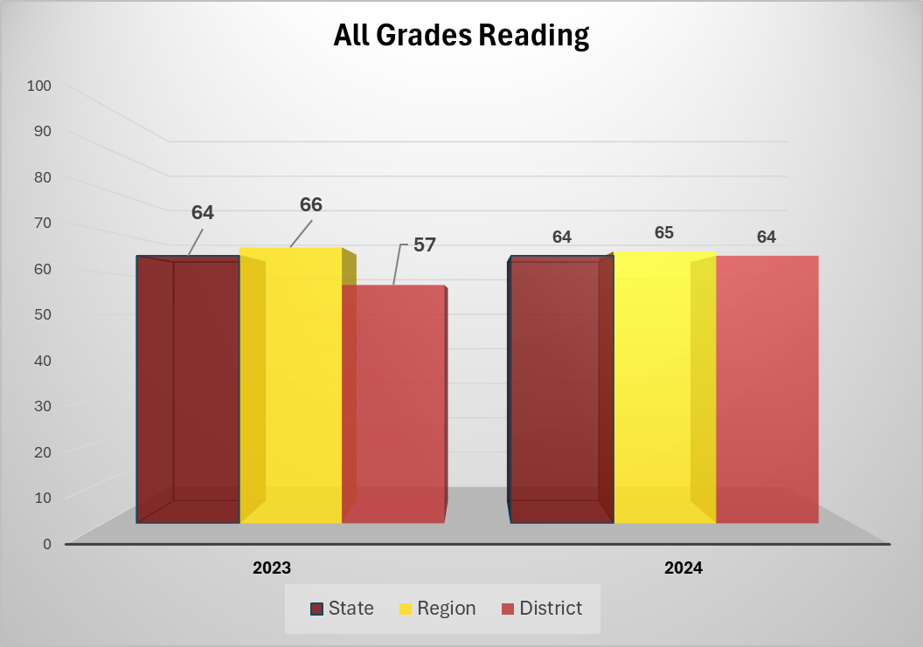
School Progress – Annual Growth

Slide 13
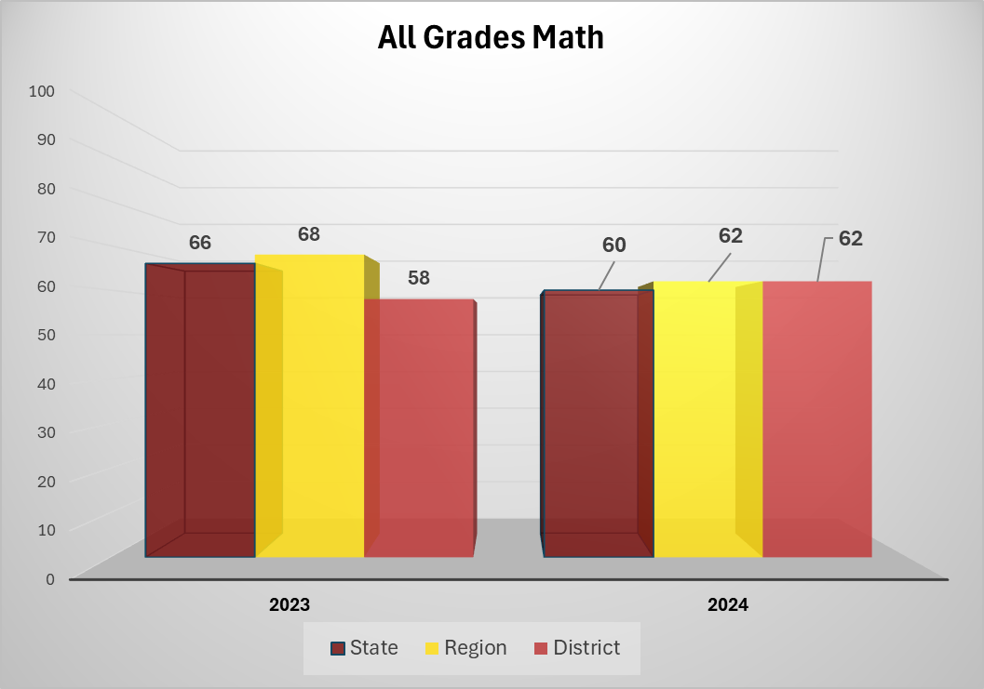
School Progress – Annual Growth

Slide 14
School Progress – Accelerated Learning
 | School Year | State | Region | District
All Grades Both Subjects | 2024 | 32% | 32% | 34%
 | 2023 | 38% | 39% | 37%
All Grades Reading | 2024 | 30% | 30% | 31%
 | 2023 | 35% | 36% | 37%
All Grades Math | 2024 | 35% | 35% | 37%
 | 2023 | 40% | 42% | 38%
Notes:
This data only looks at schools who did not meet in the previous school year.
Accelerated Learning is an area we focused on at the beginning of the year. We saw that the percentages went down in both math and reading. In order to address this we came to the Board in the Fall and purchased additional resources for the campus with the addition of IXL and have provided campuses data throughout the year to target this group of students.

Slide 15
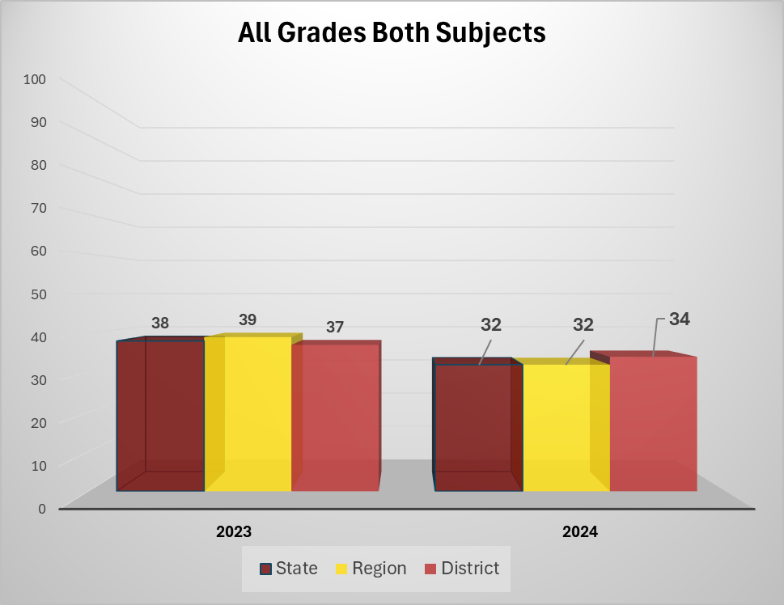
School Progress – Accelerated Learning

Slide 16
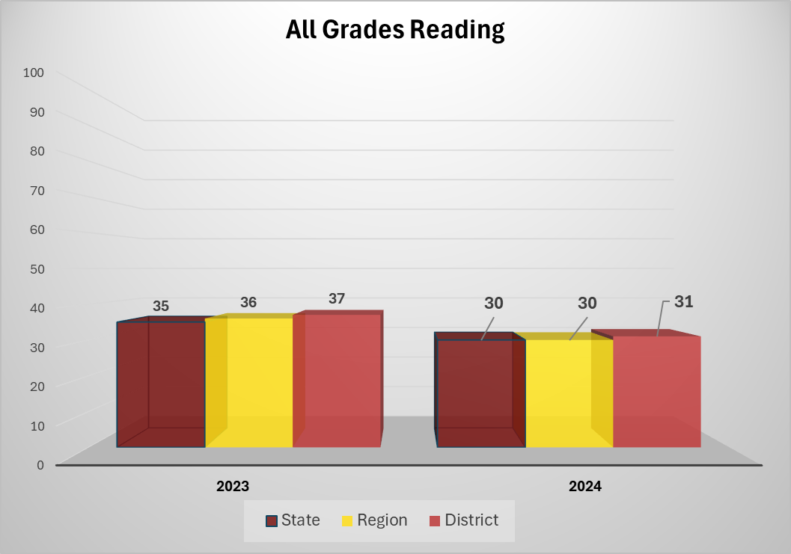
School Progress – Accelerated Learning

Slide 17
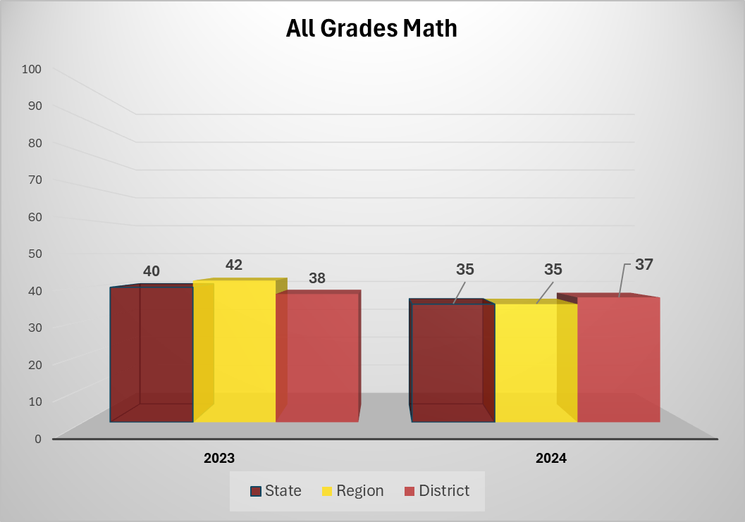
School Progress – Accelerated Learning

Slide 18
Bilingual Education/English as a Second Language
The TAPR also includes disaggregated data for various BE/ESL program instructional models and groups:
STAAR Performance – reported for 2024 and 2023
All Grades All Subjects, All Grades (RLA), All Grades (Math), All Grades (Science), All Grades (Social Studies)
Annual Growth - reported for 2024 and 2023
All Grades – Both Subjects, All Grades – RLA, All Grades – Math
Accelerated Learning - reported for 2024 and 2023
All Grades – Both Subjects, All Grades – RLA, All Grades – Math
Total BE BE Trans Early Exit BE Trans Late Exit BE Dual Two-Way BE Dual One-Way Alternative Language Program (ALP) Bilingual (Exception) ALP ESL (Waiver) | Total ESL ESL Content Based ESL Pull-Out EB/ESL with Parental Denial Never Emergent Bilingual (EB)/English Learner (EL) Total EB/EL Monitored and Former EB/EL

Slide 19
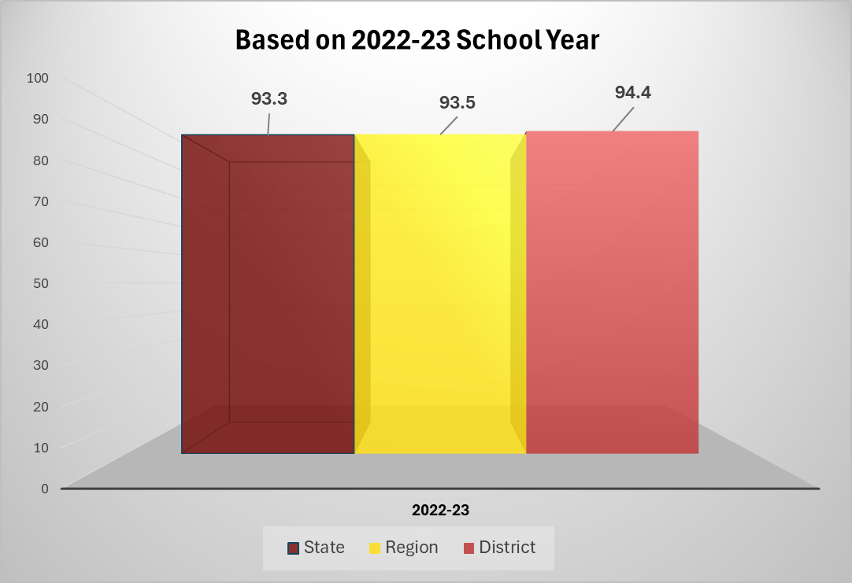
Attendance Report
Notes:
Attendance is a delayed reporting area. This information is from 2022-23 school year. This went up from 93.1% in 21-22 and we are predicting to remain the same for the 23-24 school year. Campuses are working to continue improving attendance through incentives.

Slide 20
Annual Dropout Rate (Grades 7-8)
 | 2022-23
State | 0.8%
Region | 0.7%
District | 0.3%
Notes:
Annual dropout rate

Slide 21
Annual Dropout Rate (Grades 9-12)
 | 2022-23
State | 2.0%
Region | 2.5%
District | 0.8%
Notes:
Annual dropout rate for ROHS

Slide 22
4-year Longitudinal Graduation Rate (Grades 9-12)
Class of 2023 | State | Region | District
Graduated | 90.3% | 88.5% | 94.0%
Received TxCHSE | 0.3% | 0.2% | 0%
Continued HS | 3.1% | 3.5% | 1.3%
Notes:
Graduation rate for 4 year.
We predict this to go up to 95% for Class of 2024

Slide 23
College, Career and Military Readiness Report (CCMR)
2022-2023 | State | District
College, Career, Military Graduates | 76.3% | 55.1%
College Ready Graduates | 61.9% | 44.1%
Career/Military Ready Graduates | 36.4% | 26.7%
Notes:
College, Career Military Readiness is another area that is delayed. The comparison is from 2022-23 data. CCMR is a lagging indicator which means the data from the previous school year is what is reported.
This was the year the state changed the cut score and expectation after the data was already collected. A CCMR focus group was created and we began targeting the areas correlated with CCMR.
23-24 we predict to be approximately 71%
24-25 we are currently at 63% and project to end the school year in the 80s

Slide 24
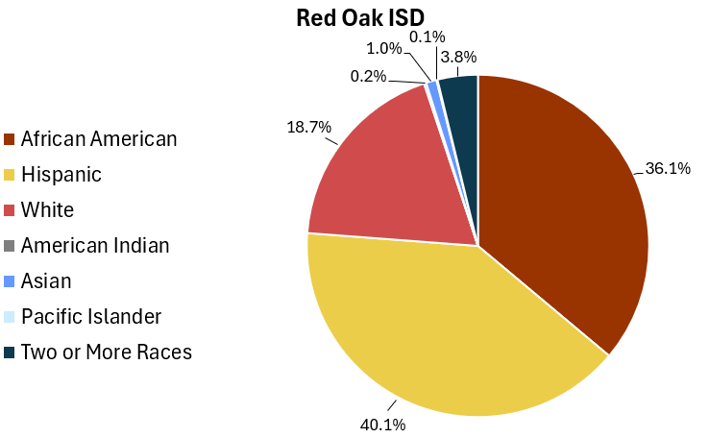
2023-2024 Student Ethnic Distribution
Notes:
Ethnic Distribution based on 2023-24 data

Slide 25
2023-2024 Student Demographics
 | State | District
Economically Disadvantaged | 62.3% | 62.9%
EB Students/EL (previously English Language Learners) | 24.4% | 15.1%
At-Risk | 53.2% | 51.8%
Notes:
Student demographics – English Language Learners are now referred to as Emergent Bilingual – EB.

Slide 26
2023-2024 Enrollment by Program
 | State | District
Bilingual/ESL | 24.5% | 13.8%
Career & Technical Education | 26.9% | 29.2%
Gifted & Talented Education | 8.5% | 6.0%
Special Education | 13.9% | 15.5%
Notes:
Program enrollment
GT – 22-23 – 6.43% currently at 5.75 and we are testing over 150 students for the final testing window
Working with Region 10 to ensure alignment

Slide 27
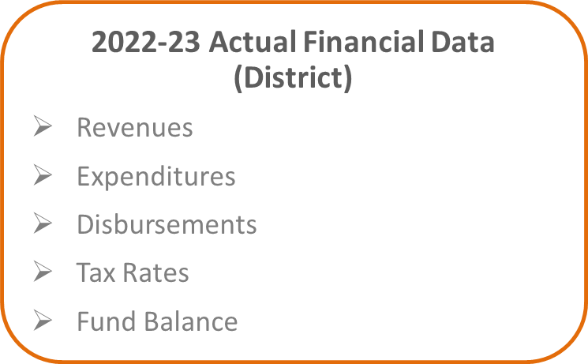
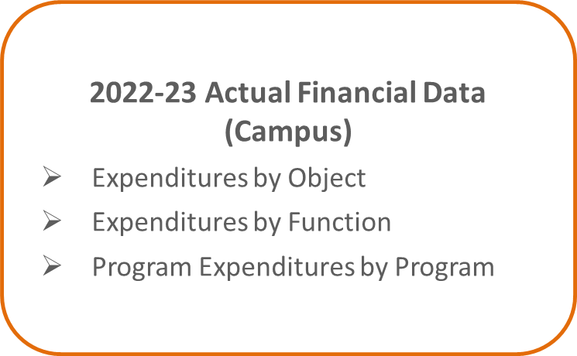

PEIMS Financial Standard Reports
(2022-23 Financial Actual Reports)
Red Oak ISD received a FIRST rating of “A - Superior Achievement”.
2022-23 PEIMS Financial Actual Reports for Districts
2022-23 PEIMS Financial Actual Reports for Campuses
Notes:
Section 2 of the annual report has been presented previously by Dr. Johnston. The PEIMS financial Standard report reviews district and campuses financial data.
The most recent FIRST rating is A

Slide 28
District Accreditation Status
The District Accreditation Status:
Accredited
Notes:
Section 3
Generally, each year TEA assigns one of four accreditation statuses to each district in the state:

Slide 29
Campus Performance Objectives
Campus Performance Objectives and progress toward meeting those objectives may be found in each Campus Improvement Plan.
Plans are located on the Red Oak ISD website.
Plans are also available for review at the district's central office or at your campus.
Notes:
Section 4
Campus Performance Objectives are presented yearly and monitored by campus and district throughout the school year. These performance objectives are based on data analysis and needs assessment and each campus periodically measures progress toward its performance objectives. Copies of campus improvement plans are available online or at campus or district offices.

Slide 30
Violent or Criminal Incidents on campuses
There are 18 Discipline Codes considered to be violent or criminal.
2023-2024 ROISD
  Code 12 – Unlawful Carrying of a Location-Restricted Knife
    JJAEP- *
  Code 30 – Aggravated Assault Against someone other than a school district employee or volunteer
    ROHS - *
  Code 46 – Aggravated Robbery
    ROHS - *
* To comply with FERPA, data are marked with an asterisk (*) if the number is less than 5.
Notes:
Section 5
Texas Education Code requires each district to publish, as part of its Annual Report, a report on violent or criminal incidents that occur at each campus
The report must include
Number, rate and type of violent or criminal incidents that occurred on each campus (to the extent permitted under FERPA)
Descriptions of school violence prevention and violence intervention policies and procedures used to protect students
The district’s report for the 2022-23 school year is available for review at the district’s central office and at each campus in the district

Slide 31
Violent or Criminal Incidents on campuses
ROISD school violence prevention and violence intervention polices, and procedures used to protect students:
  Student Handbook and Code of Conduct
  ROISD School Board Policy Manual
  ROISD Administrators and Counselors
  Crime Stopper Online Form
  StopIt
  School Safety audits
Notes:
Section 5
ØTEC Section 39.306 requires each district to publish, as part of its Annual Report, a report on violent or criminal incidents that occur at each campus
ØThe report must include
Number, rate and type of violent or criminal incidents that occurred on each campus (to the extent permitted under FERPA)
Descriptions of school violence prevention and violence intervention policies and procedures used to protect students
The district’s report for the 2023-24 school year is available for review at the district’s central office and at each campus in the district

Slide 32
ROISD Student Performance in Post Secondary Institution
Data compiled by the Texas Higher Education Coordinating Board (THECB)
The most current report is for 2022-23 High School Graduates
  Student performance is measured by the Grade Point Average (GPA) earned by 2022-23 high school graduates who attended public four-year and two-year institutions of higher education in fiscal year 2024
 | Total Graduates | <2.0 | 2.0-2.49 | 2.5-2.99 | 3.0-3.49 | >3.5 | Unknown
Four-Year Public University | 116 | 36 | 12 | 17 | 24 | 22 | 5
Two-Year Public Colleges | 139 | 58 | 13 | 21 | 19 | 24 | 4
Independent Colleges & Universities | 24
Not Trackable | 12
Not Found | 232
Total High School Graduates | 523
Notes:
Section 6 ROISD Student Performance in Post Secondary Institutions
This information is complied by the Texas Higher Education Coordinating Board and provided to the district.
"Not found" graduates have standard ID numbers that were not found in the specified year at Texas higher education institutions.
"Not trackable" graduates have non-standard ID numbers that will not find a match at Texas higher education institutions.

Slide 33
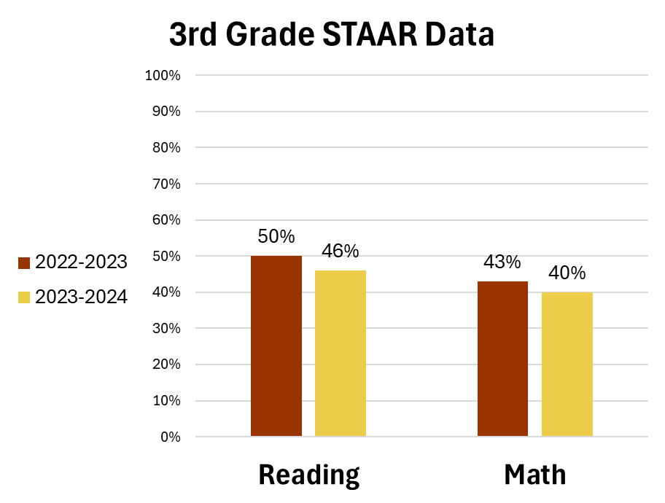
Progress HB3 Goals – Early Childhood Literacy and Math
Notes:
Section 7 Progress Toward Board-adopted HB 3 Goals
HB3 focuses on 3rd grade performance in literacy and math. This is focused on meets. As we shared at the beginning of the year – our goal is 60% at Meets by 2028. There are several steps the Curriculum department has taken to move towards this goal.

Slide 34
HB3 Goals – Professional Development
ELA
Grade Level Curriculum Training
  K/1 - Literacy Footprints (Shared Reading), Stations & Guided Reading, Phonics (Saxon) and Writing
  2nd – SAVVAS (Reading), Saxon (Phonics), Writing, Guided Reading and Stations
  3rd – SAVVAS (Reading), Writing (Carlin Liborio) and Word Study
Writing Calibration and Scoring
iReady
Reading Academy and Reading Academy coaching sessions
Ellevation EB strategies
Math
Grade Level Curriculum Training
  K-3 Stemscopes
The 5E (Engage, Explore, Explain, Elaborate, Evaluate) +IA (Intervention and Acceleration) Model
iReady
Reflex/FRAX (Math fact fluency)
Vertical Alignment with Region 10 trainer
Notes:
Section 7

Slide 35
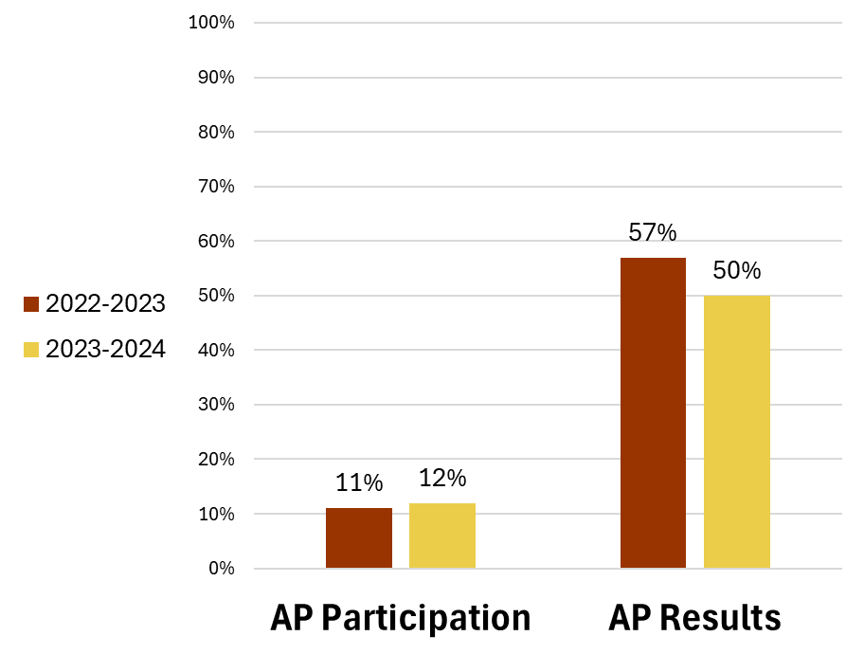
Progress HB3 Goals - CCMR
Notes:
Section 7
The goal in this area is a 2% increase in participation and passing rate. The percentage for participation remained the same and there was as increase in passing rate.

Slide 36
HB3 Goals – Professional Development
CCMR​
AP Curriculum Review​
Region 10 Partnership​
New College Board Report​
Increase participation in AP exams​
Ongoing CCMR committee meetings​
Target student plans for CCMR
Notes:
Section 7

Slide 37
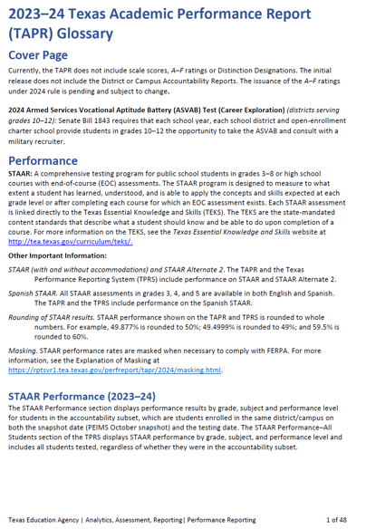
Glossary
Each year, TEA prepares and publishes a TAPR Glossary
The TAPR Glossary provides definitions, describes methodologies, and lists sources for each data point in the TAPR
A Spanish version of the TAPR Glossary is scheduled for release in early 2025
Notes:
Section 8 is the final section.
Every year TEA prepares and publishes a TAPR glossary.

Slide 38
Resources and Availability of Annual Report
The District's TAPR will be posted on the district's website within 2 weeks after this meeting
Paper copies will also be available at the district's central office and on each campus in the district
For questions or more information, contact:
Megan Corns
Chief Technology Officer
Red Oak ISD
972-617-2941
megan.corns@redoakisd.org
Notes:
The District's TAPR will be posted on the district's website within 2 weeks after this meeting.
Paper copies will also be available at the district's central office and on each campus in the district.

